Slide 1
Data Analytics Track first wave 2024

Slide 2


Sales store Dataset Analysis project
Data Analytics Track
first wave 2024
Team creative

Slide 3






Team members
Amal Hassan
Analysis the data using Python and Tableau
Emad Ezzat
Analysis the data using Python and SQL
Ahmed El Sayed
Analysis the data using Tableau
Menna Yasser
Answer analysis questions using python
Walaa Khayal
Analysis the data
Using Power point for presentation
Haidy Sabry
Analysis the data using Tableau

Slide 4
01
Phase: Cleaning, preprocessing Dataset

Slide 5
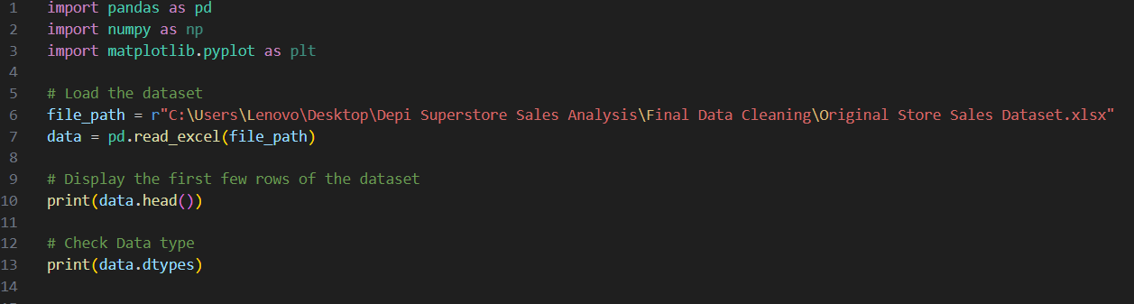
Dataset Loading
Importing Libraries and Extracting Data
Data Type Inspection
Ensuring the data is correctly recognized for further analysis.

Slide 6
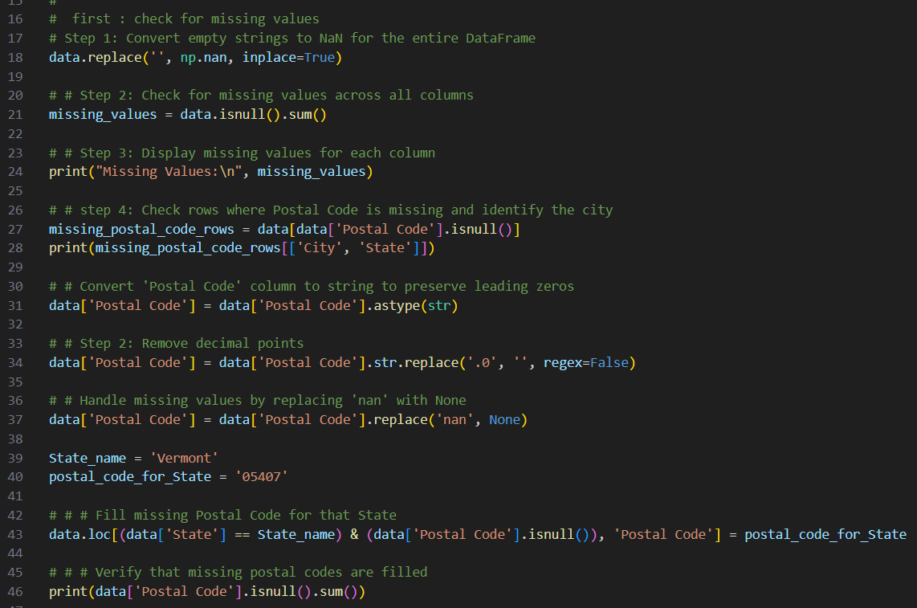
Data Cleaning and Preprocessing
01
Handling Missing Values
Standardizing Missing Data
Identifying Missing Data
Addressing Missing Postal Code
Postal Code Format Correction

Slide 7
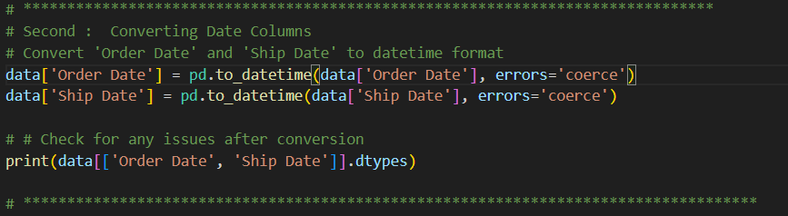
02
Date Format Conversion
The 'Order Date' and 'Ship Date' columns were converted to a consistent date format.

Slide 8
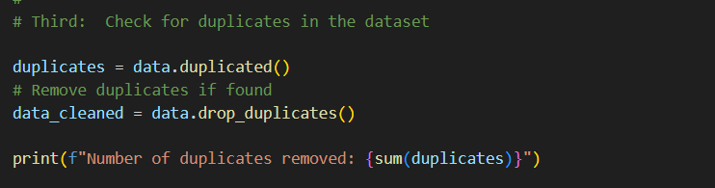
03
Duplicate Record Handling
This step ensured data integrity and prevented potential distortions in subsequent analysis

Slide 9
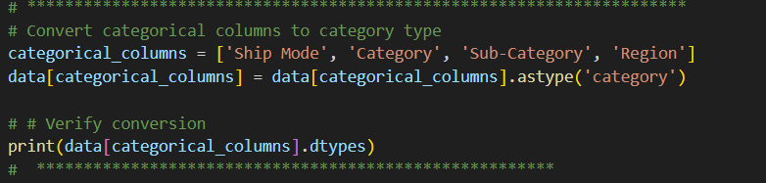
04
Converting Categorical Columns
Key categorical columns such as 'Ship Mode', 'Category', 'Sub-Category', and 'Region' were converted into categorical data types.
This conversion helped optimize memory usage and enhanced processing efficiency

Slide 10
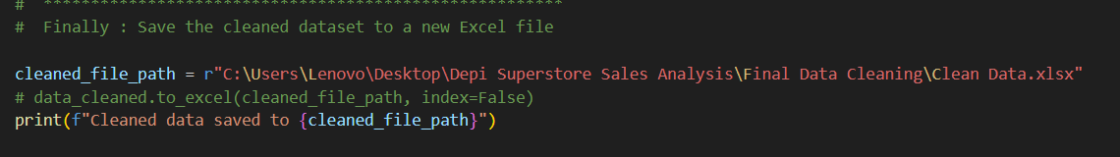
Saving the Cleaned Dataset
The cleaned dataset was saved into a new Excel file.
This ensured that all transformations were preserved.
The dataset was ready for future analysis and reporting.

Slide 11
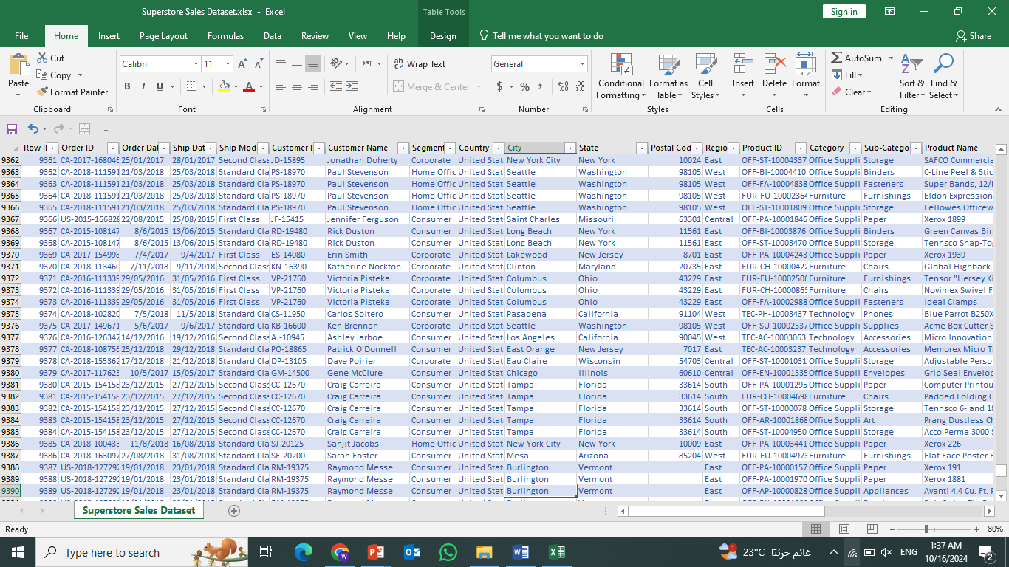

Slide 12
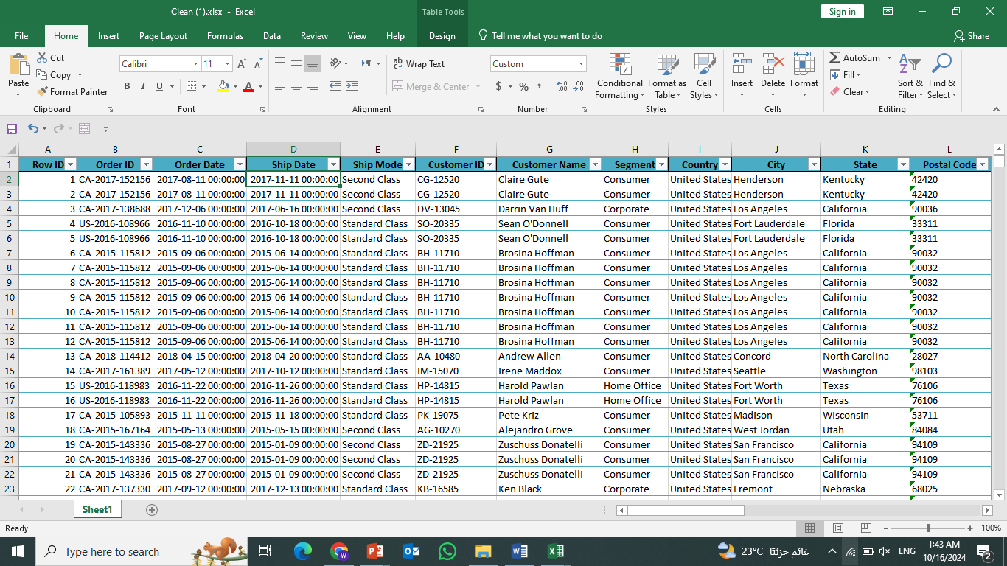
Cleaned Dataset

Slide 13
Data visualization using Python
import matplotlib.pyplot as plt
import pandas as pd
import seaborn as sns
df = pd.read_excel('C:/Users/user/Downloads/clean.xlsx')

Slide 14
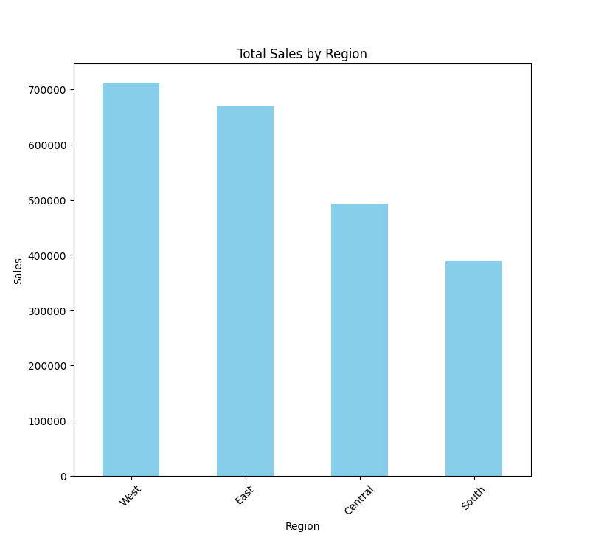
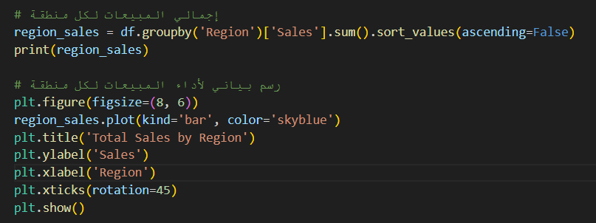
What is the total sales per region?

Slide 15
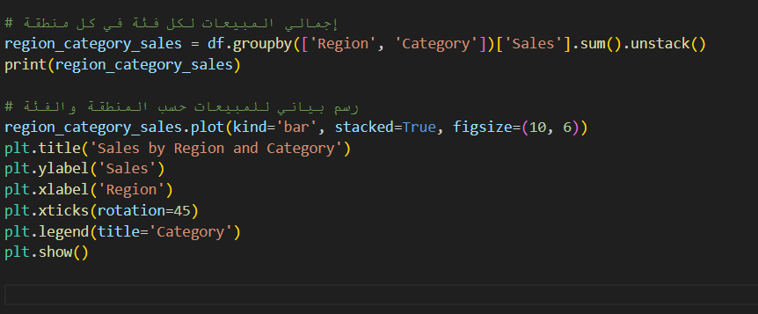
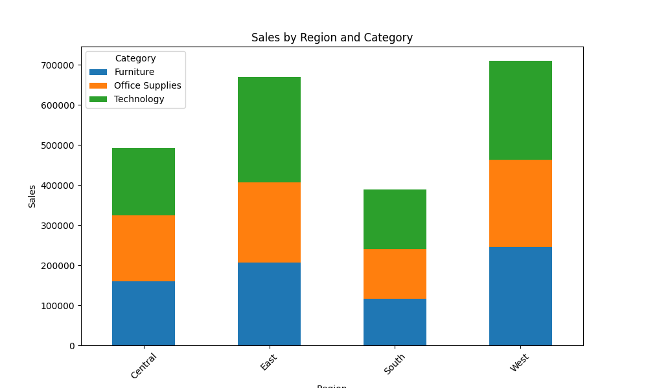
What are the total sales for each category in each region?

Slide 16
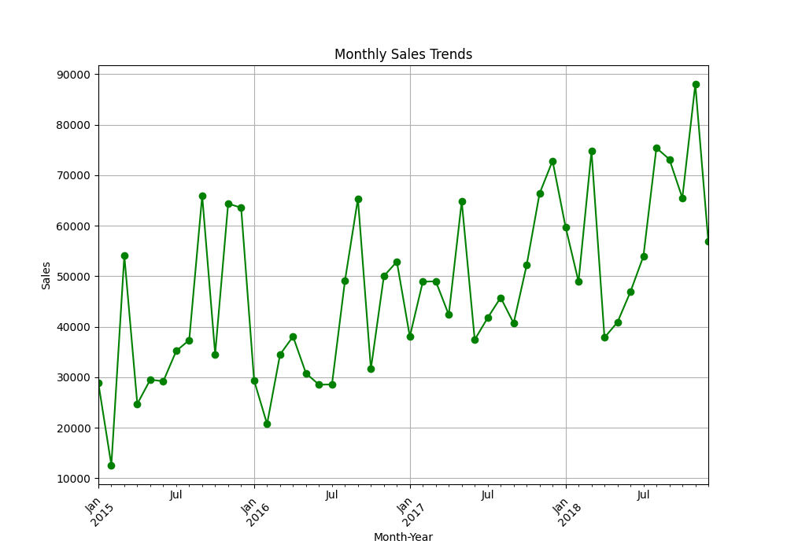
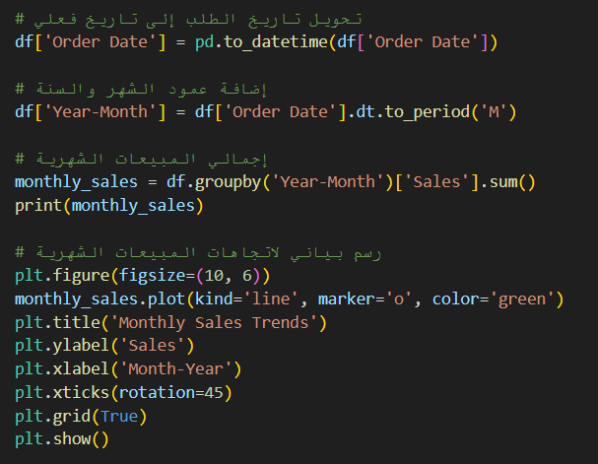
What is your total monthly sales?

Slide 17
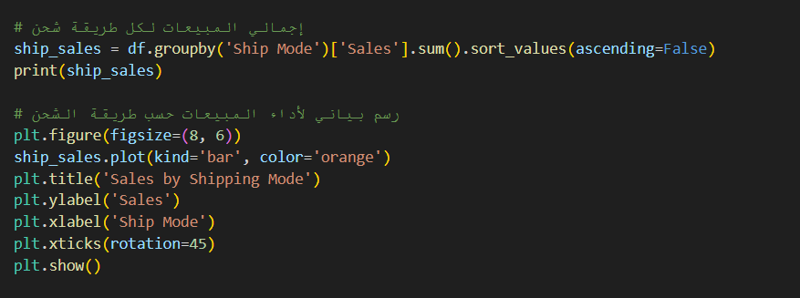
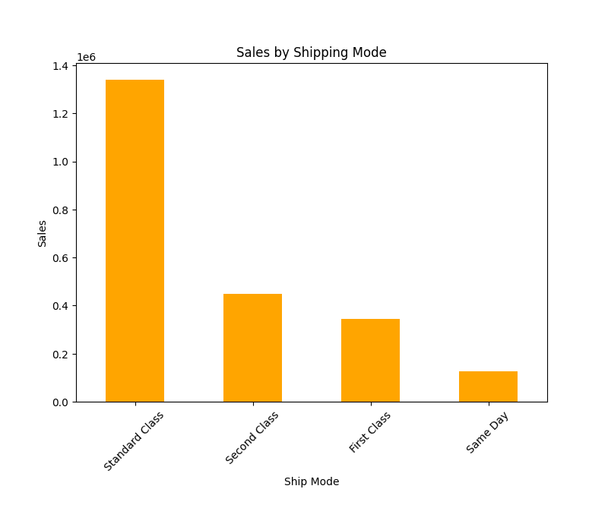
What are the total sales for each shipping method?

Slide 18
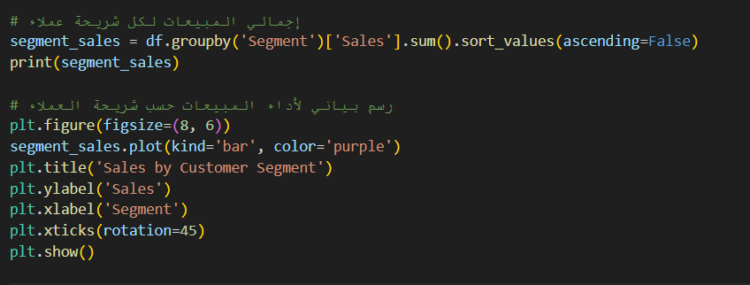
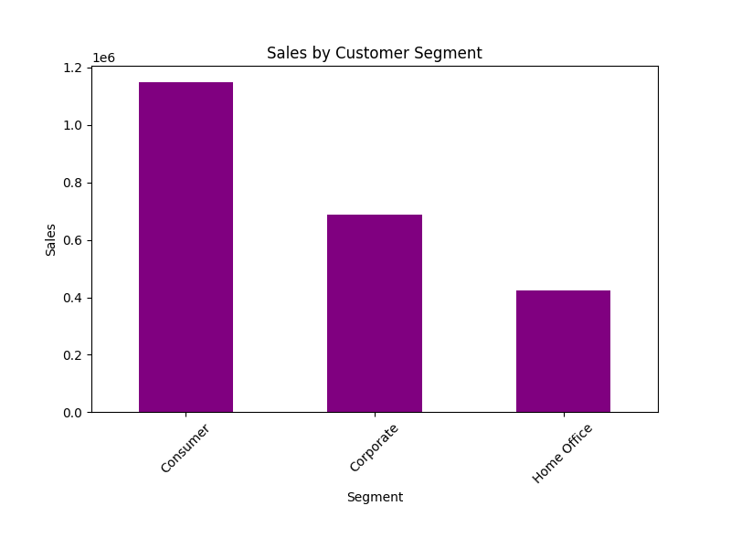
What is the total sales for each customer segment?

Slide 19
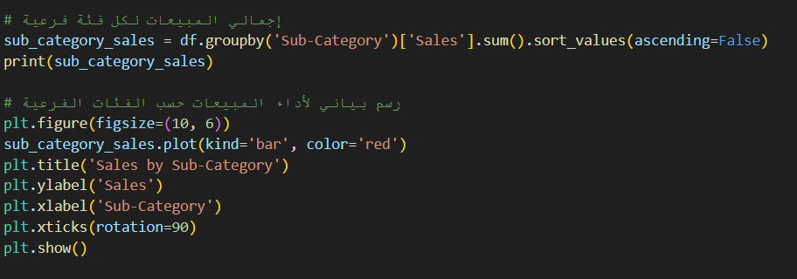
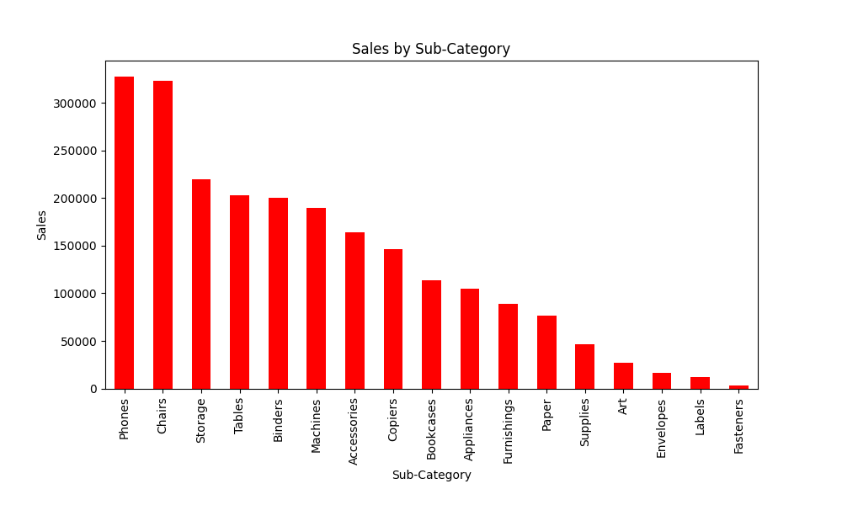
What is the total sales for each subcategory?

Slide 20
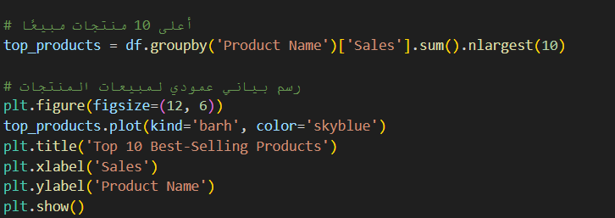
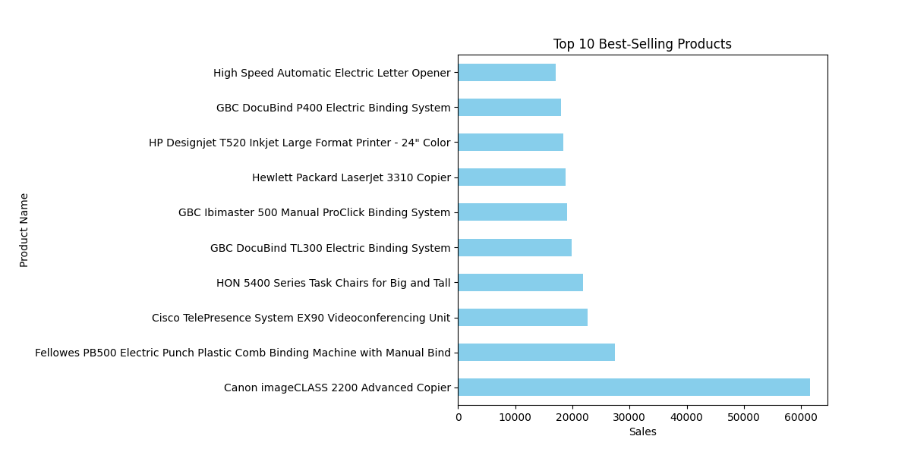
What are the best selling products?

Slide 21
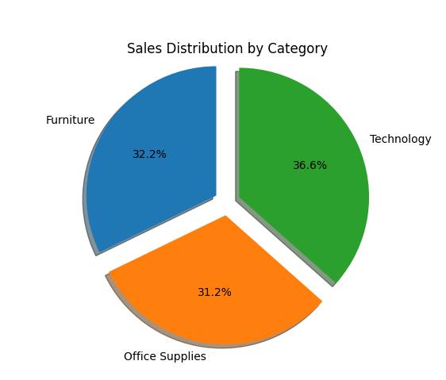
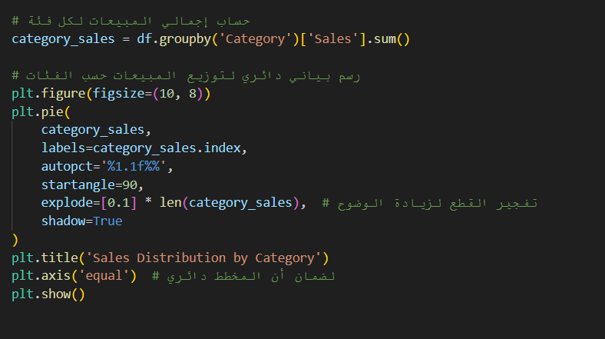
What is the distribution of sales by category?

Slide 22
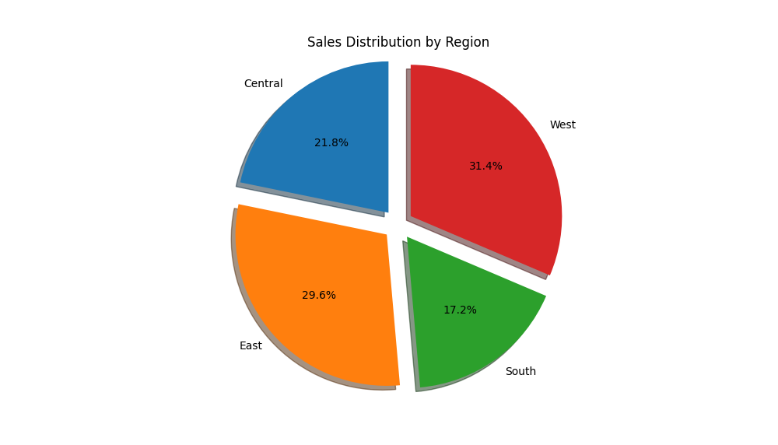
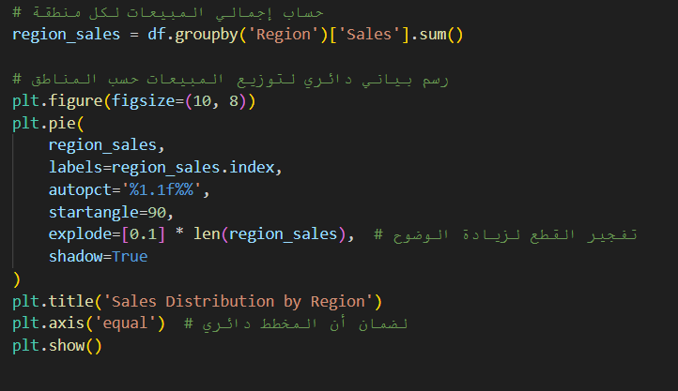
What is the distribution of sales by region?

Slide 23
Data Modeling for Superstore Database

Slide 24
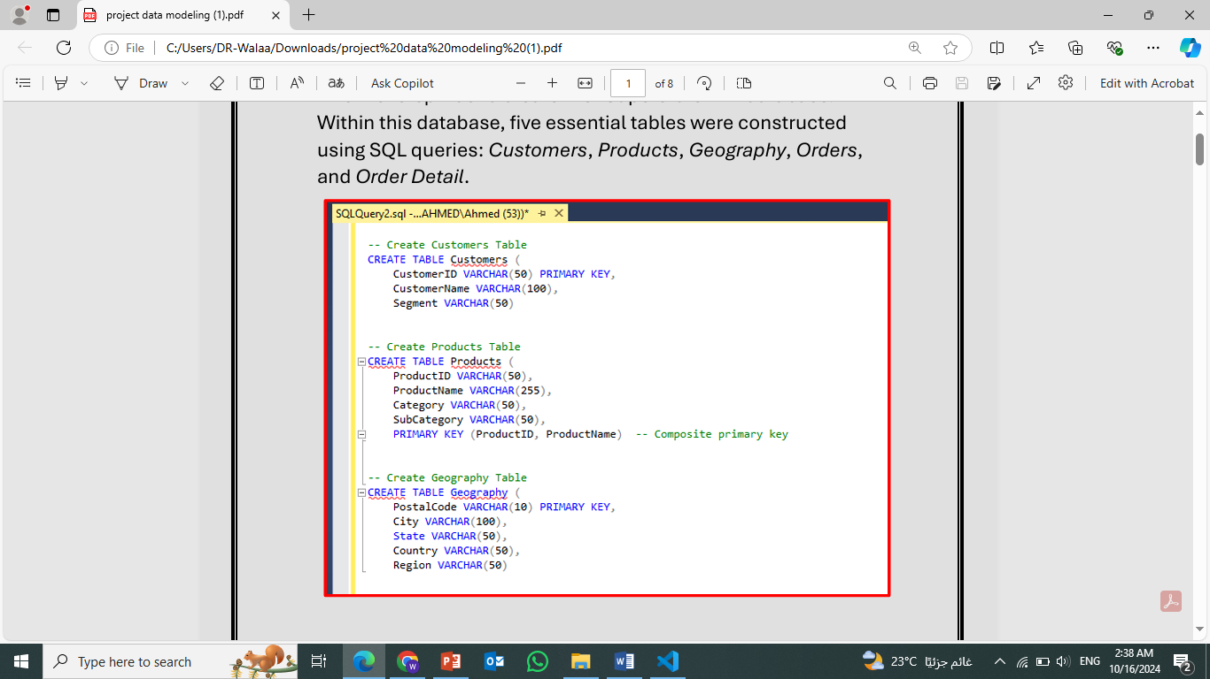
Database Creation and Table Setup:
The first step was to create the "Superstore DB" database. Within this database, five essential tables were constructed using SQL queries: Customers, Products, Geography, Orders, and Order Detail.

Slide 25
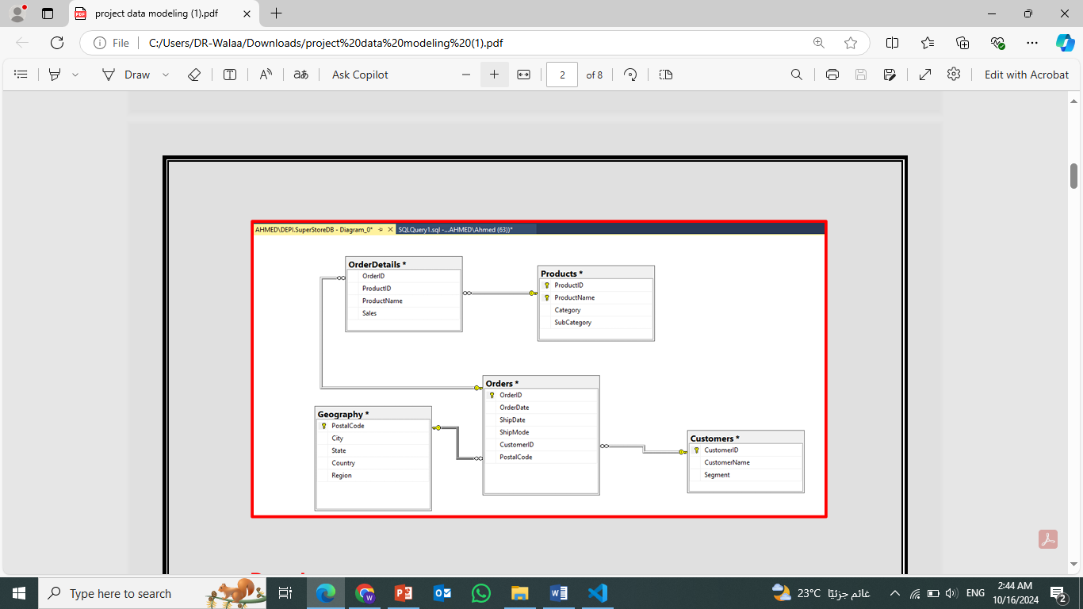
Establishing Relationships and Diagram:
After creating the tables, the next phase involved linking them together to form a relational model. The relationships between the tables were established and visualized in a diagram, representing the connections between entities.

Slide 26
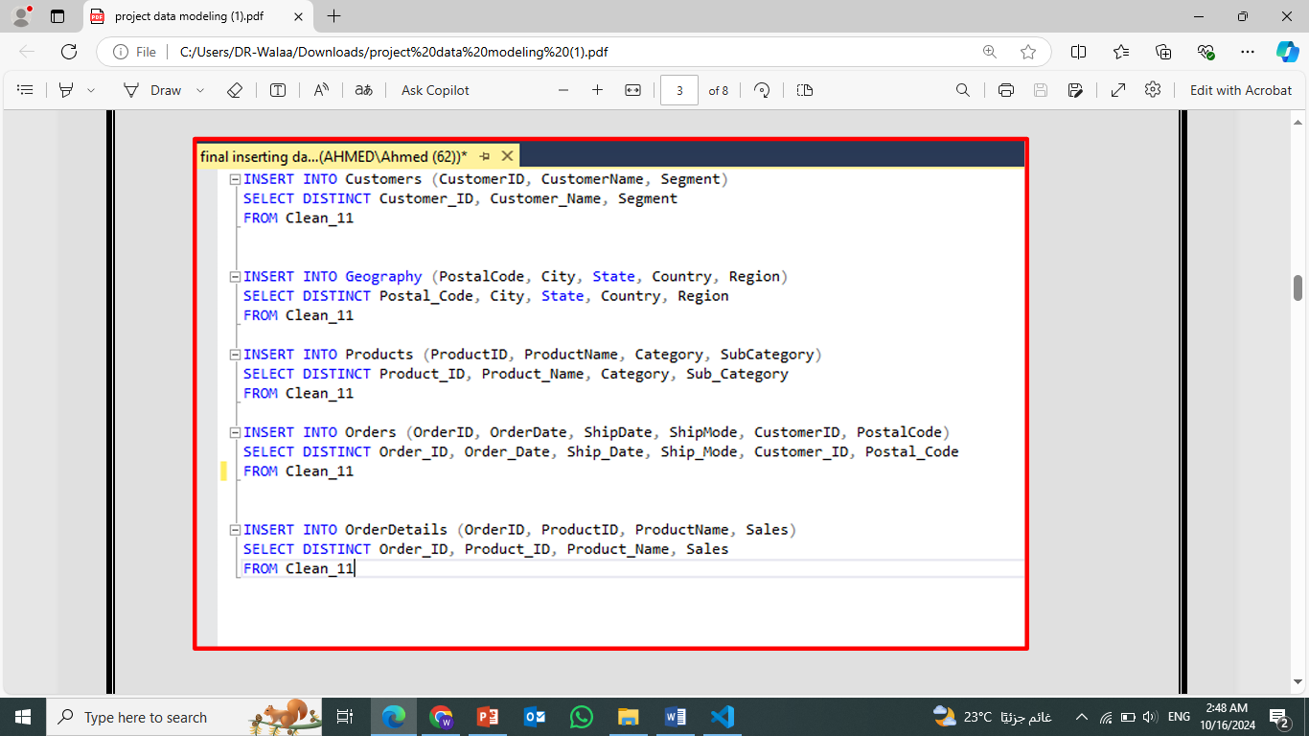
Data Import:
The dataset was then imported into the database. This data was added into the respective tables, adhering to the established relational structure.
Data Extraction and Loading:
Data was extracted from external sources and loaded into the relational tables using SQL queries. This ensured the accurate and structured integration of data into the database.

Slide 27
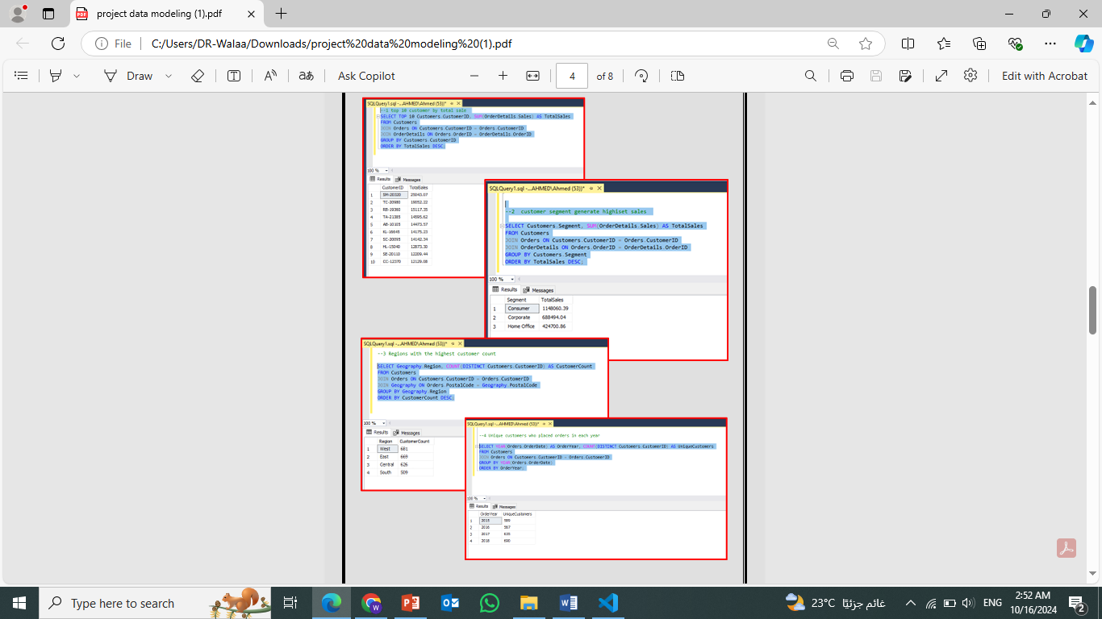
Insights and KPIs Extraction:
Using SQL queries, various insights and key performance indicators (KPIs) were extracted from the database. These insights provided valuable information for business analysis.

Slide 28
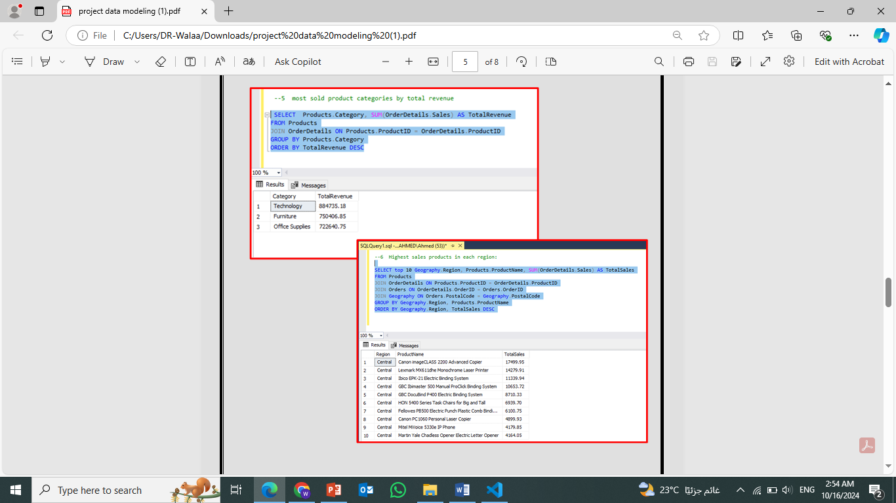
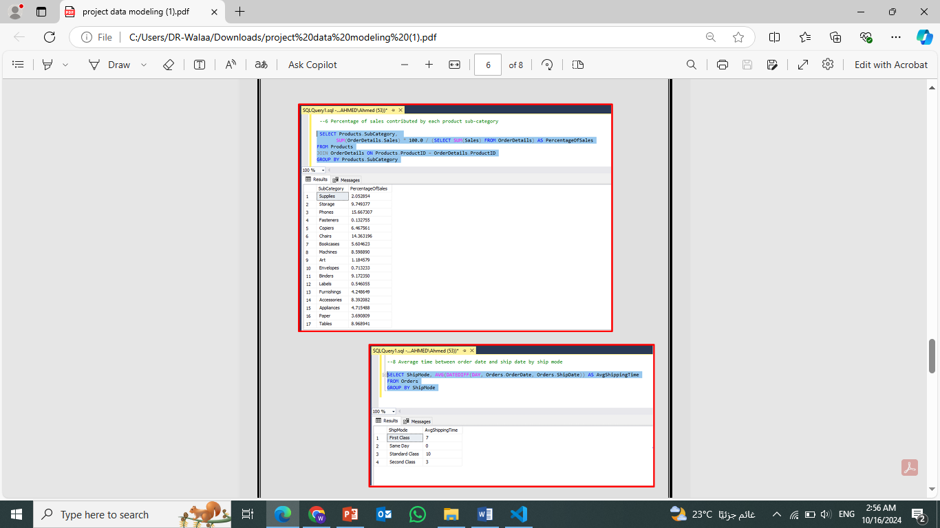

Slide 29
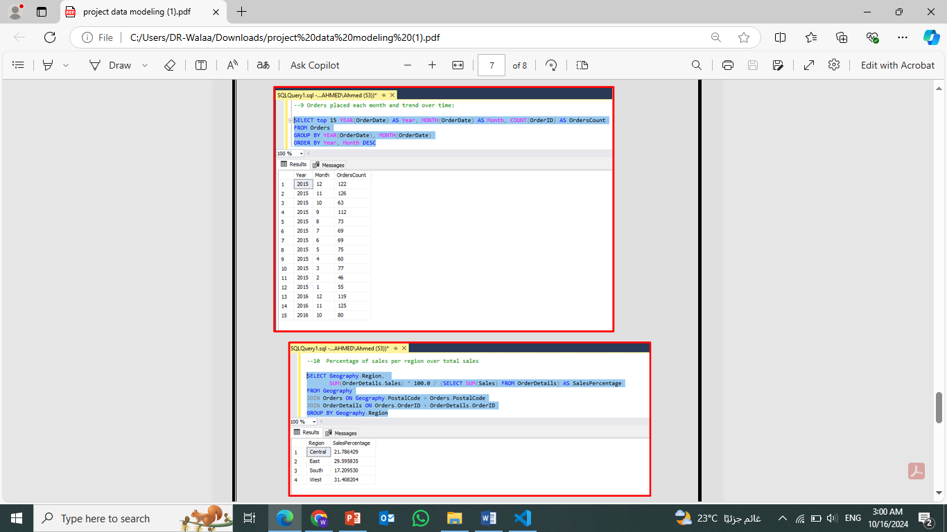
Database Backup:
Finally, a complete backup of the database was performed to ensure data security and availability for future use.

Slide 30
Forecasting Report

Slide 31
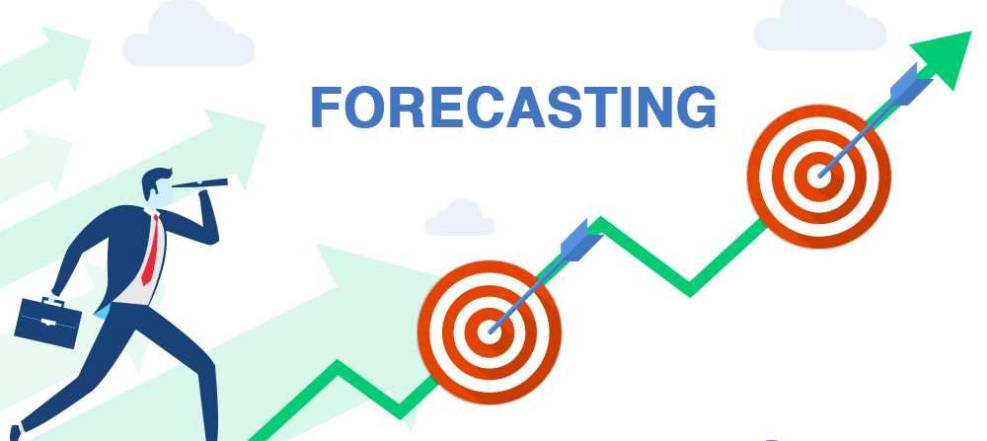
We have prepared a set of forecasting questions that we needed answers to in order to get a better picture of the upcoming work.
The first question we aimed to answer was forecasting sales for the next year, focusing on time series sales

Slide 32
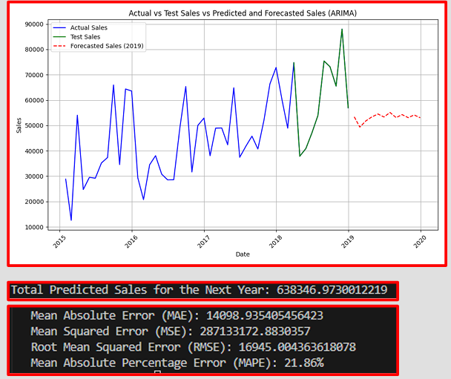
we used a linear regression model, but after evaluating it, the results were far off from what we expected. As a result, we moved on to a more advanced approach using the ARIMA model, which we also evaluated. However, as it turns out, the predictions were still significantly off from the actual values

Slide 33
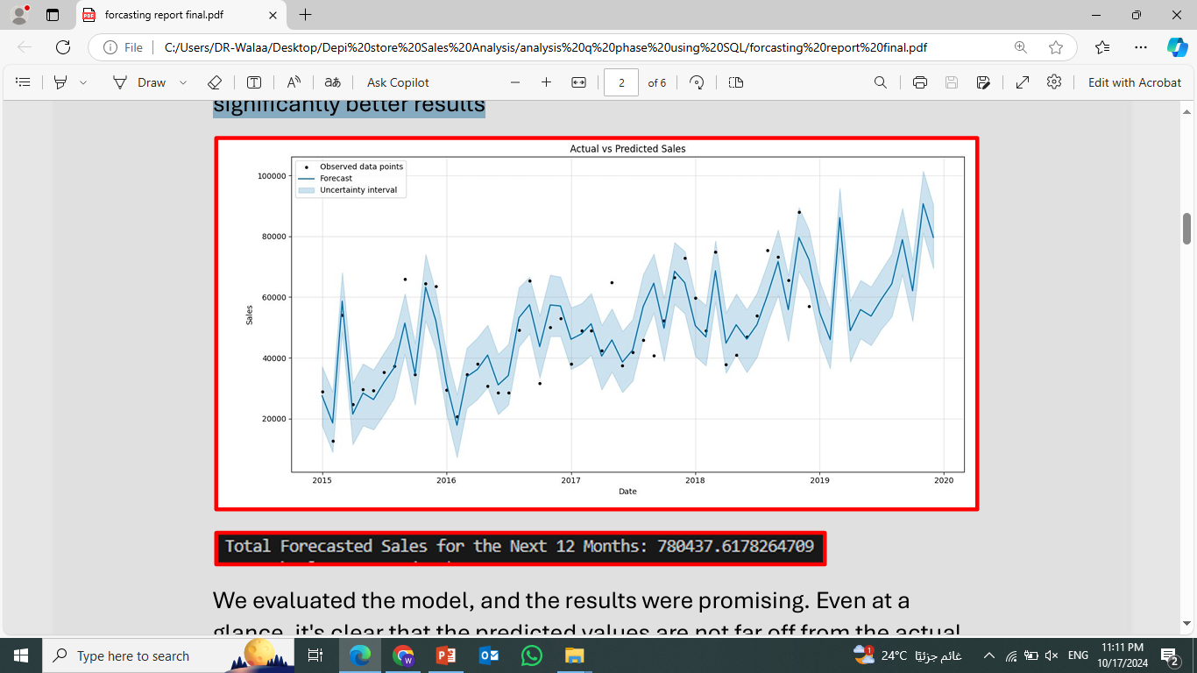
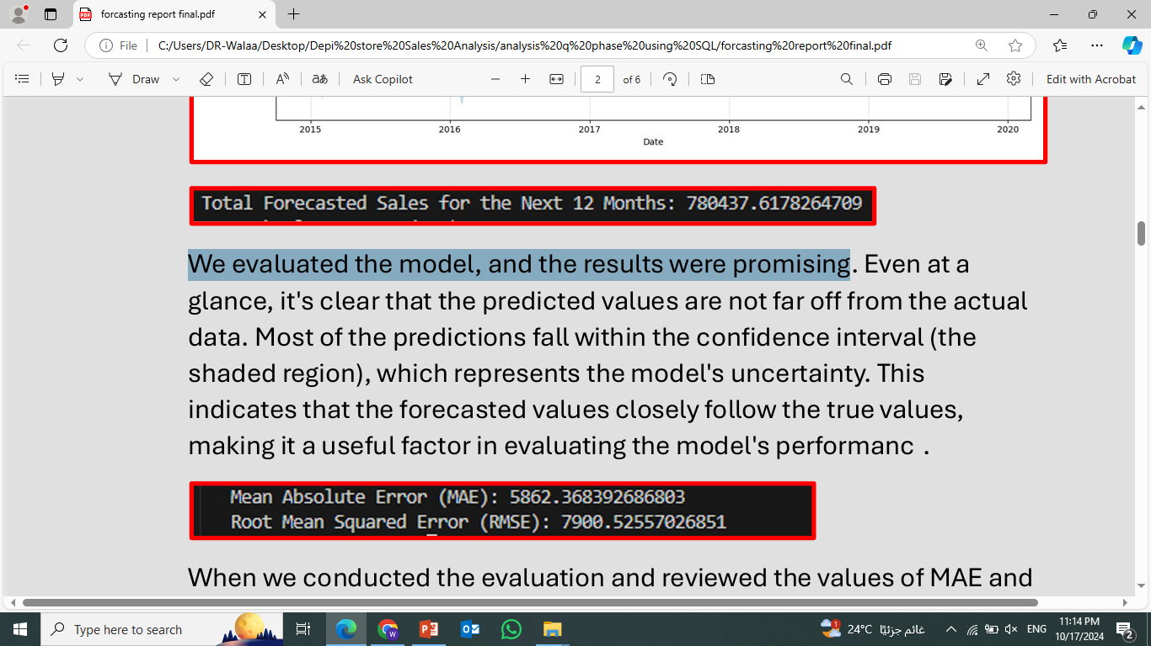
we utilized the Prophet model, which provided us with significantly better results
We evaluated the model, and the results were promising

Slide 34
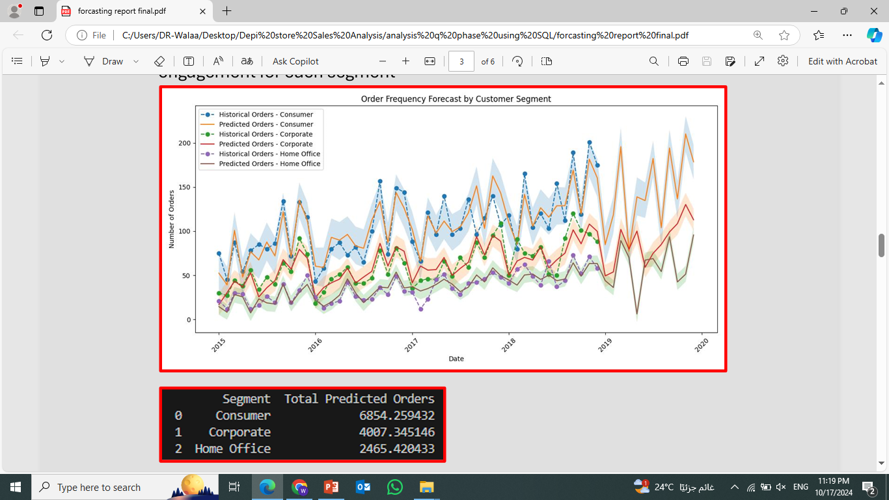
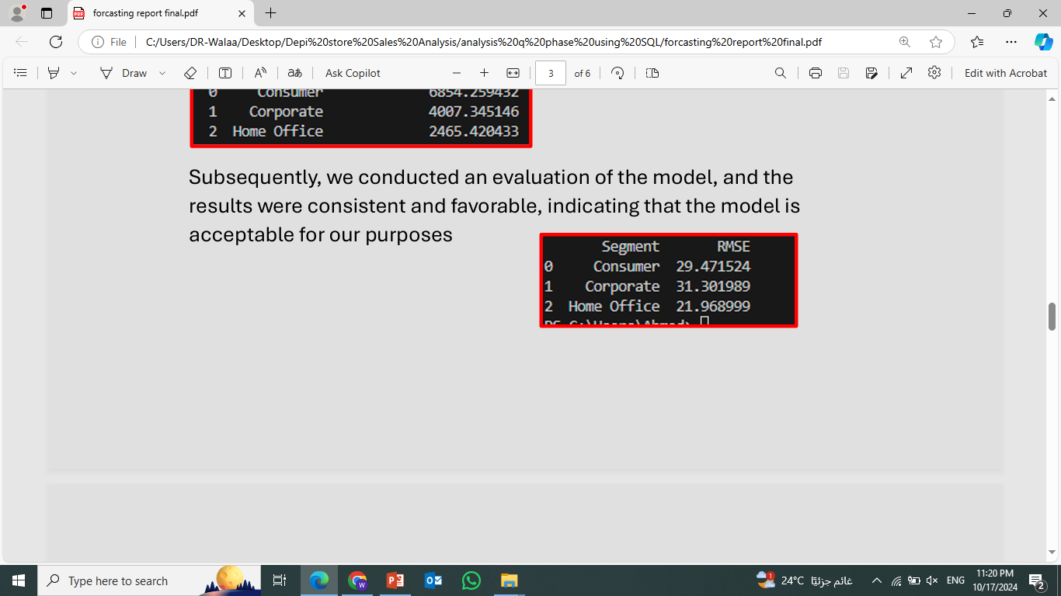
What is the expected future order frequency for specific customer segments?
By using statistical models and forecasting techniques.
we conducted an evaluation of the model, and the results were consistent and favorable.

Slide 35
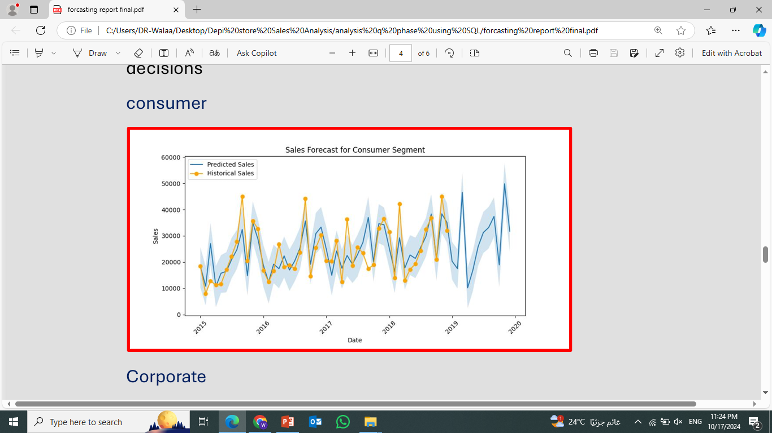
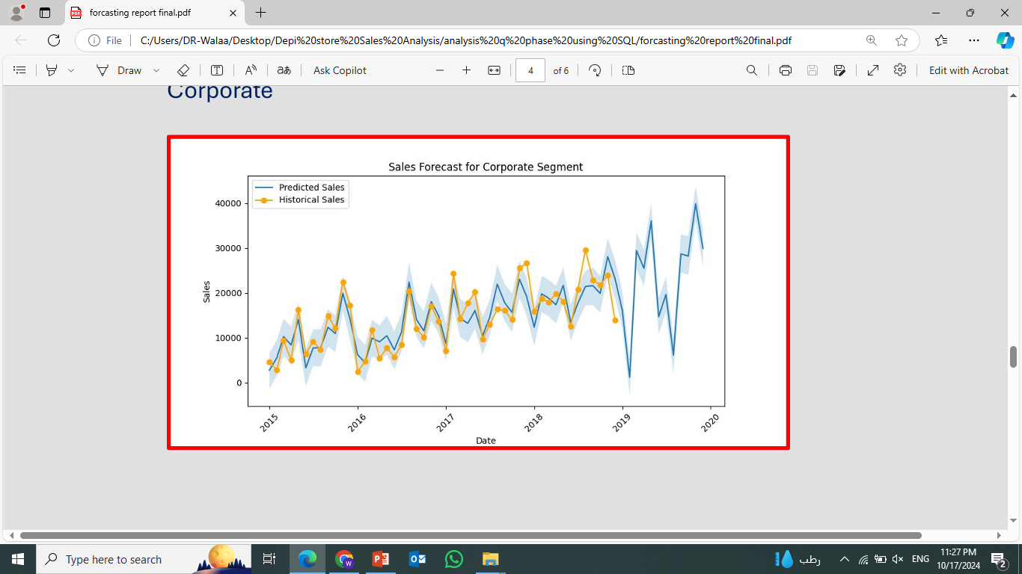
Which customer segments will contribute the most to future sales?
consumer
corporate

Slide 36
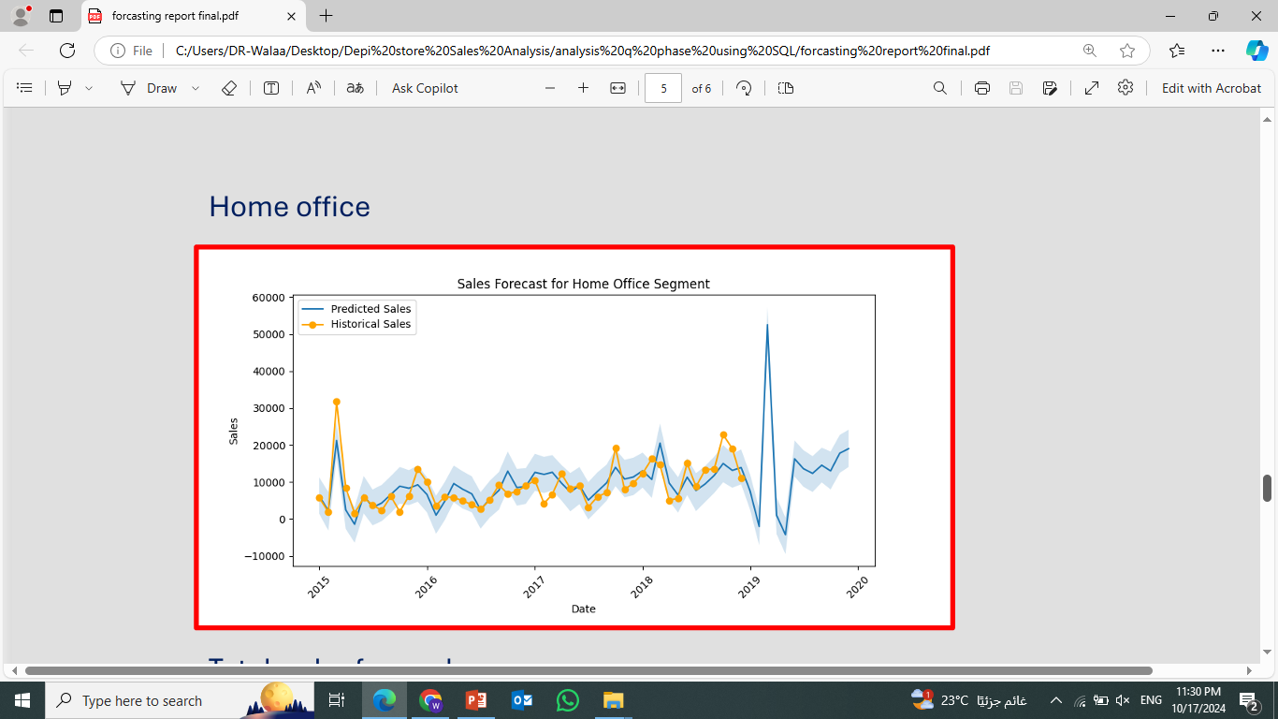
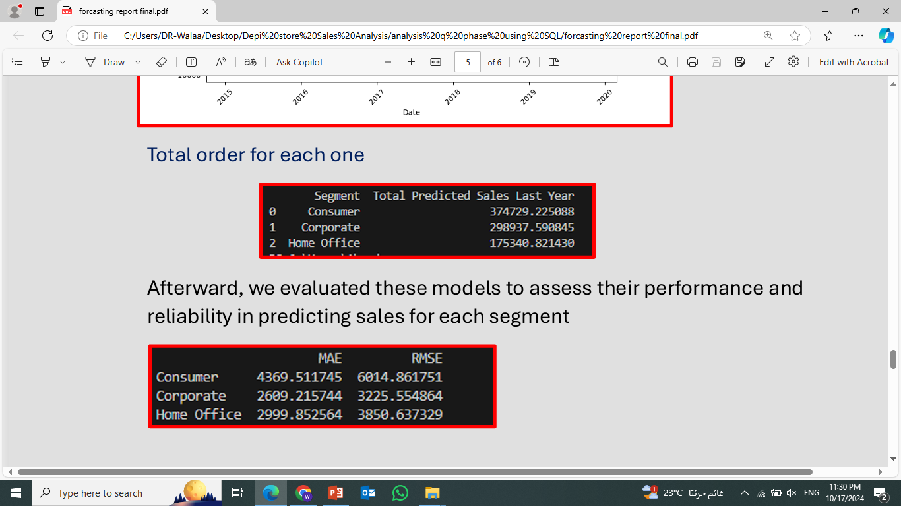
Home office
Total order for each one
Predicting sales for each segment

Slide 37
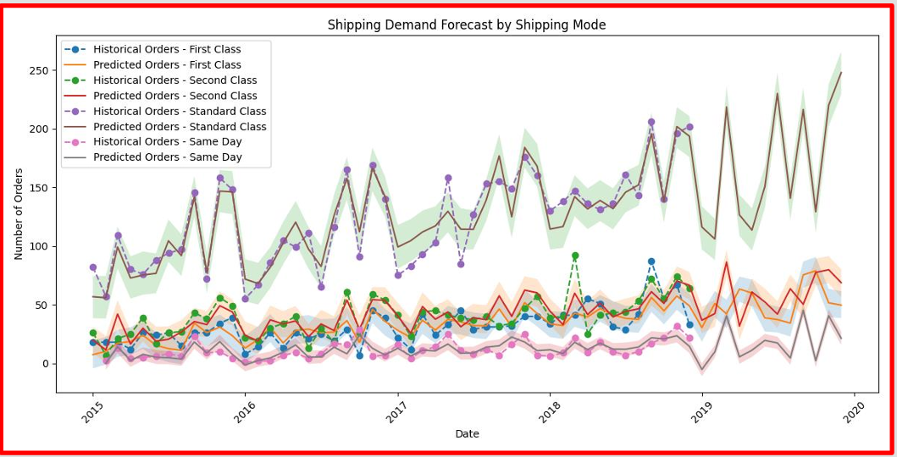
Which shipping modes will likely experience the highest demand in the near future?
Based on our analysis, standard class shipping methods, such as express and overnight delivery, are projected to experience the highest demand in the near future

Slide 38
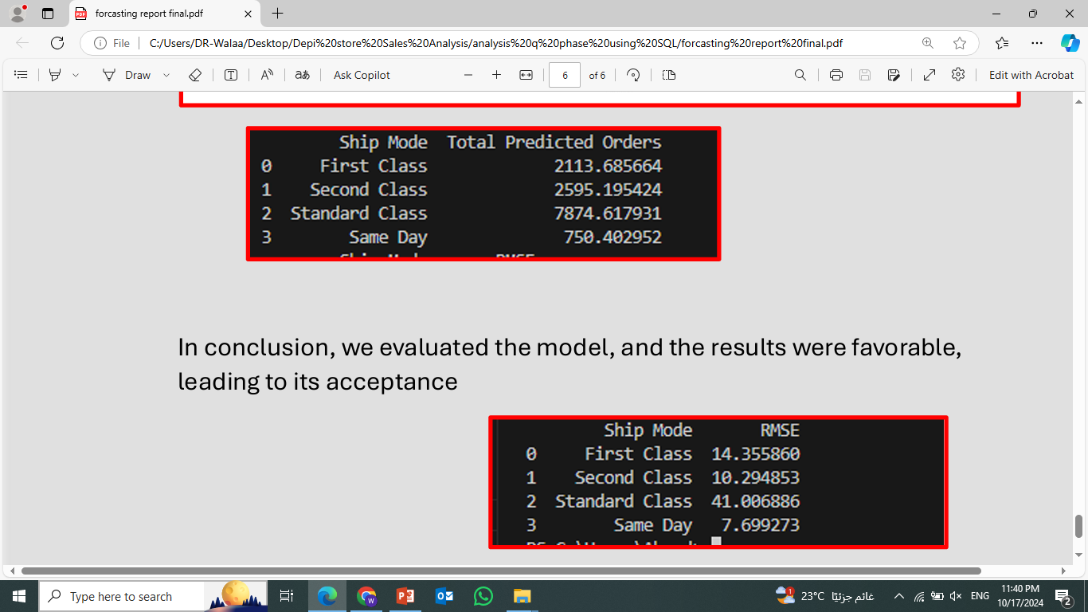
After Evaluating the model

Slide 39
Dashboard using Tableau

Slide 40
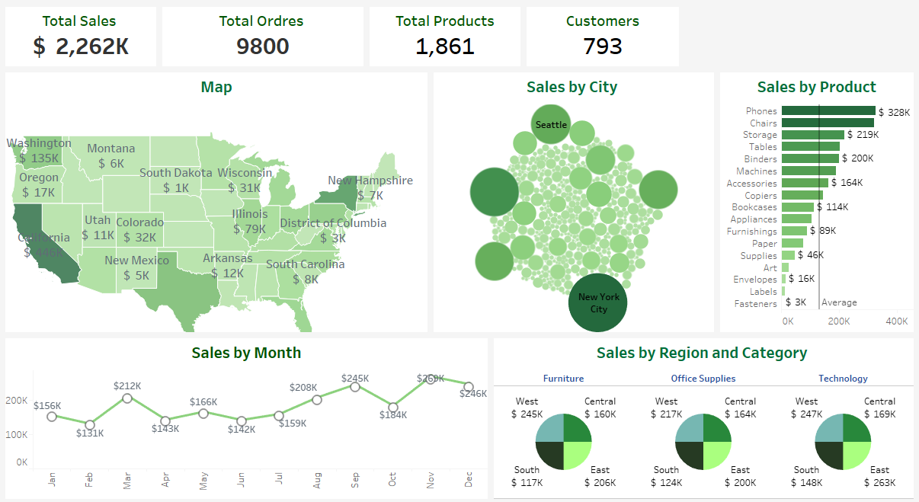
Sales Overview Dashboard

Slide 41
Sales Overview Dashboard
Recommendation:
Focus marketing efforts in high-performing regions like California and replicate successful strategies in other states.
Continue promoting top-selling products while identifying opportunities to improve the sales of lower-performing products.

Slide 42
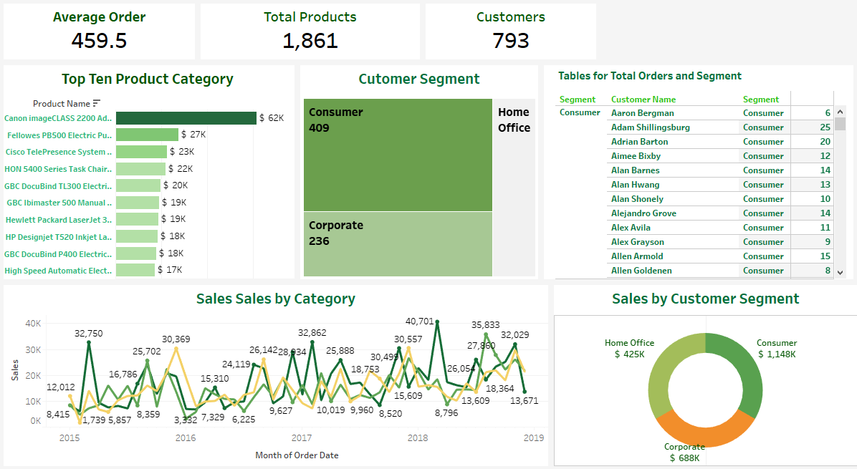
Customer & Orders Dashboard

Slide 43
Customer & Orders Dashboard Recommendation:
Introduce targeted promotions for the Corporate segment to increase their contribution to sales.
Leverage the popularity of top-selling products to develop bundled offers or upsell opportunities.

Slide 44
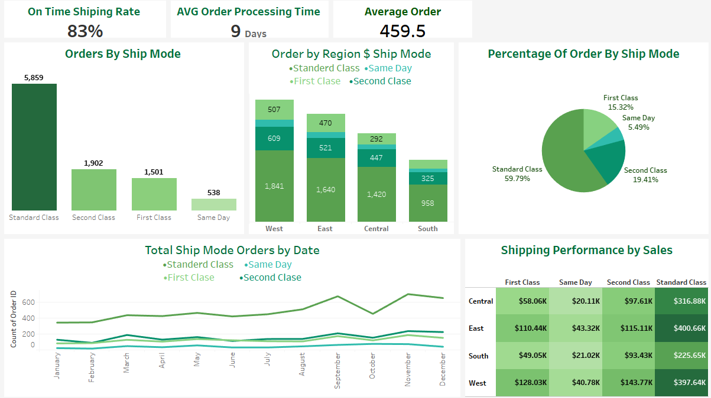
Operations & Shipping Dashboard

Slide 45
Operations & Shipping Dashboard Recommendation:
Evaluate the cost-effectiveness of Standard Class shipping, as it is the most utilized option.
Investigate opportunities to improve the on-time delivery rate by optimizing logistics processes.
Consider offering promotional discounts for faster shipping options to encourage their use and increase customer satisfaction.

Slide 46
Conclusion
The analysis of the store's sales and operations through has provided a detailed understanding of performance across different facets of the business.
By focusing on high-performing products, optimizing shipping processes, and targeting key customer segments, the store can continue to drive growth and improve customer satisfaction.

Slide 47
"Thank you for joining me in exploring the findings of this analysis I would be happy to provide further clarification on the topics we've covered."

